Slide 1


DC Water and Sewer Authority
Larry Baucum & Jamiu Ayeolayinka

Slide 2
Company Intro and Active Directory Naming Conventions
DC Water is a District of Columbia government independent authority that provides drinking water, public fire hydrant water distribution, and wastewater treatment services for D.C. and parts of Maryland and Virginia.
DC water has a main office that is the brain of the organization , two branch offices that are water pumping stations, and the blue plains wastewater treatment plant. DC water also has 1100 employees that work on-site, off-site, and roam the wastewater treatment plant.
The naming conventions used in our active directory configuration follow a straightforward logic to make everything clear and readable at a glance.
Domain naming: The domains are named based on their location or purpose preceding the root which is dcwater.com. The main office is hq.dcwater.com and wastewater plant is plant.dcwater.com this is purpose-based naming. The branch offices use location-based naming Branch office 1 is B.dcwater.com and Branch office 2 is O.dcwater.com which are the street names of the branches.
Host naming: We handle employee account naming using the first name, last name, and the first four digits of their employee I.D. number. Customer accounts use their account number as their identifier.
Group naming: We name our departments based on what purpose they serve for our organization. An example of this would be Board Members for the board members and higher-level executives, HR for human resources, Marketing for the marketing department., and so on.
Server naming: Our servers are named according to their location, purpose, and number. As an example the main office has hq-DNS1, hq-DNS2, hq-DHCP1, and hq-DFS1.

Slide 3
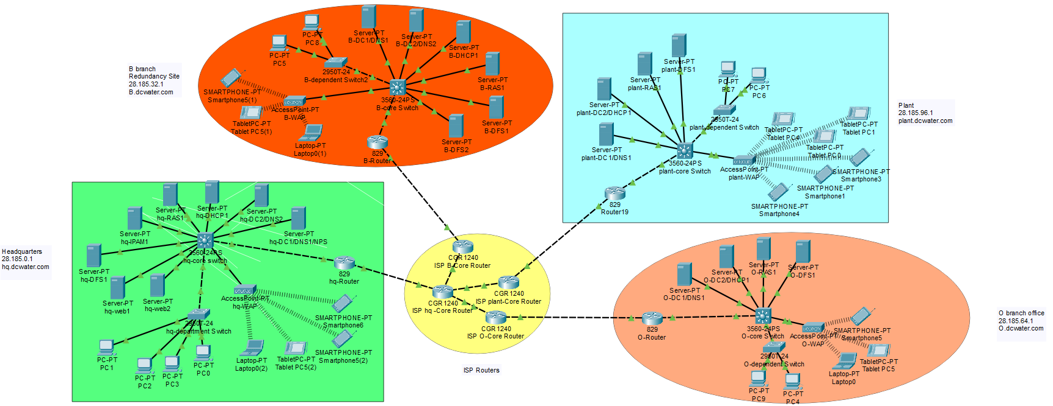
Network Layout

Slide 4
Active Directory Setup
2 Domain controllers per location. The first domain controller will handle domain responsibilities such authenticating user access and the second domain controller will be configured to handle primary responsibilities for downtimes due to updating. The secondary DC will also provide redundancy, and fault tolerance.
DNS and NPS(RADIUS) will reside on the primary domain controller for headquarters and connect to the other domains using trusts to provide centralized authentication, authorization, and accounting for our WAP’s and VPN. There is an extra DNS for caching at headquarters. There is an extra DNS at B branch for redundancy of our SOA, A, AAAA, CNAME, NS records.
RAS is at every location to provide WPA2 wireless access to on-site employees using WAP’s and to provide EAP-TLS VPN access to off-site employees.
IPAM will handle address management for the entire network centralized from the headquarters .
DHCP will be at every location for dynamic address assignment across all domains in the network.
DFS will be at every location to provide file replication and file sharing. There will be an extra DFS server at B branch for redundancy and overall fault tolerance.
NANO server was not included as it was not needed for load balancing or containerized applications.

Slide 5

References
DC water at a glance. (n.d.). DC Water. https://www.dcwater.com/dc-water-glance
About DC Water. (n.d.). DC Water. https://www.dcwater.com/about-dc-water
whole, T. dount. (2023, March 6). How many domain controllers should we have?. The Donut Whole. https://www.thedonutwhole.com/how-many-domain-controllers-should-we- have/#:~:text=Microsoft%20recommends%20a%20minimum%20of,or%20due%20to%20malicious%20attacks.
What is AAA?. (n.d.). FreeRADIUS Documentation. https://networkradius.com/doc/current/concepts/introduction/AAA.html
Jason, Gerend. (n.d.). Network policy server (NPS). Microsoft Learn. https://learn.microsoft.com/en-us/windows- server/networking/technologies/nps/nps-top
Validation list. (n.d.). IBM. https://www.ibm.com/docs/en/i/7.3?topic=authentication-validation-list
Khdownie. (n.d.). Extensible authentication protocol (EAP) for Network Access. Microsoft Learn. https://learn.microsoft.com/en- us/windows-server/networking/technologies/extensible-authentication-protocol/network-access
Types of VPN protocols: Nordlayer Learn. (n.d.). NordLayer. https://nordlayer.com/learn/vpn/types-and-protocols/
Vivek. (2022, November 28). EAP-TLS vs. EAP-TTLS/PAP. SecureW2. https://www.securew2.com/blog/eap-tls-vs-eap-ttls-pap
Jason, Gerend. (n.d.). Plan NPS as a radius server. Microsoft Learn. https://learn.microsoft.com/en-us/windows- server/networking/technologies/nps/nps-plan-server

